Slide 1
CURRENT CHINESE FASHION TRENDS
Room 1 members:
146284 - Tracy Wangui
142092 – Edward Aribu

Slide 2




Key Trends
1. Reimagined Tradition
2. Streetwear Dominance
3. Sustainability Matters
4. Tech-Infused Fashion
5. Gender Fluidity
6. Local Designer Spotlight - International recognition for Guo Pei, Angel Chen, and Feng Chen Wang.
7. Influencer Impact - Social media influencers drive fashion trends and brand endorsements.
8. E-Commerce and Livestreaming
9. Pandemic-Influenced Style

Slide 3
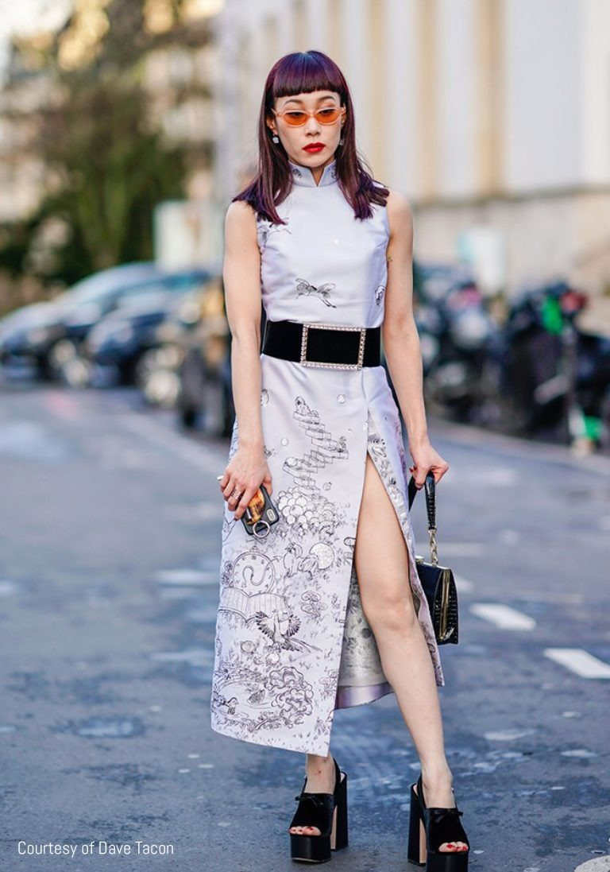
Reimagined traditional elements
Modern fashion designers have reimagined the qipao by modifying its shape, length, fabric, or color, making it more suitable for contemporary tastes and occasions. The fusion of streetwear and traditional elements, which creates a unique and edgy style that appeals to urban youth.
The revival of Hanfu, the ancient clothing of the Han Chinese people, which has become a popular subculture among young Chinese who seek to express their heritage and appreciation for classical beauty. Hanfu is characterized by loose robes, long sleeves, and elegant patterns, often inspired by nature or mythology

Slide 4

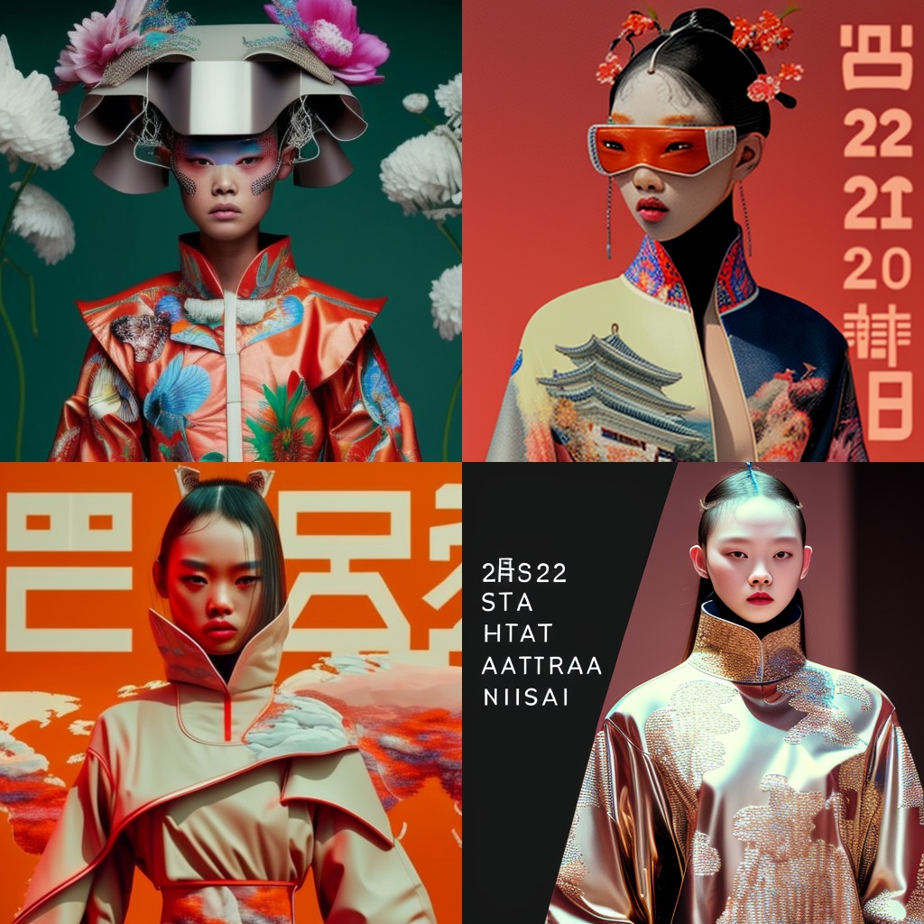
Sustainability in fashion
The rising awareness and interest of Chinese consumers for sustainable fashion, especially among the younger generation, who are more exposed to environmental issues and social causes has contributed to:
1. Adoption more eco-friendly practices and technologies, such as using organic cotton, recycled materials, or digital printing.
2. Use natural fabrics, support local craftsmanship, or empower women through their products

Slide 5
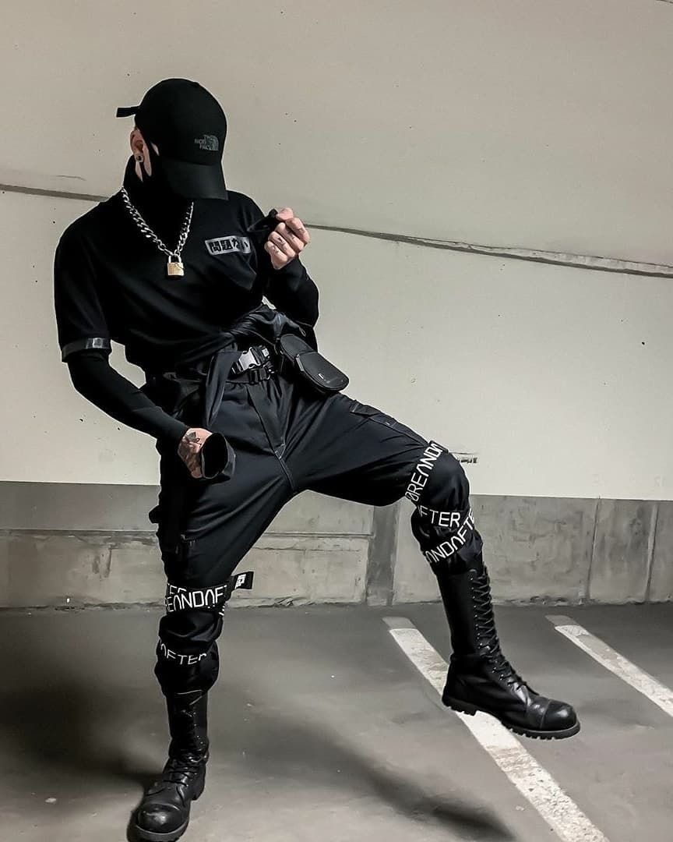
TECH-INFUSED FASHION IN CHINESE FASHION
The use of NFTs, or non-fungible tokens, to create virtual clothing, accessories, or avatars that can be worn or displayed online or in the metaverse, that are unique, scarce, and verifiable.
The integration of smart fabrics and wearable devices into fashion design, which can enhance the functionality, comfort, and interactivity of clothing.
The application of artificial intelligence and big data to fashion production, marketing, and consumption, which can improve the efficiency, quality, and personalization of fashion products and services.

Slide 6
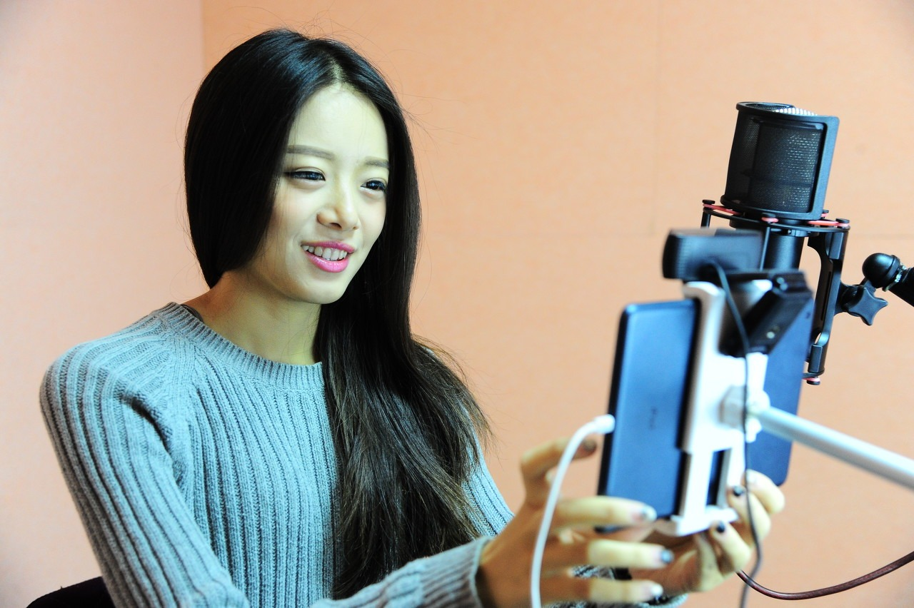
E-COMMERCE AND LIVESTREAMING
E-commerce platforms in China offer a variety of features and services for fashion shoppers, such as product reviews, social media integration, personalized recommendations, and online payment options.
Livestreaming has become a popular way for fashion brands and influencers to showcase their products and interact with their audiences in real time.
Livestreaming can boost sales conversion, brand awareness, and customer loyalty by creating an immersive and engaging shopping experience.

Slide 7
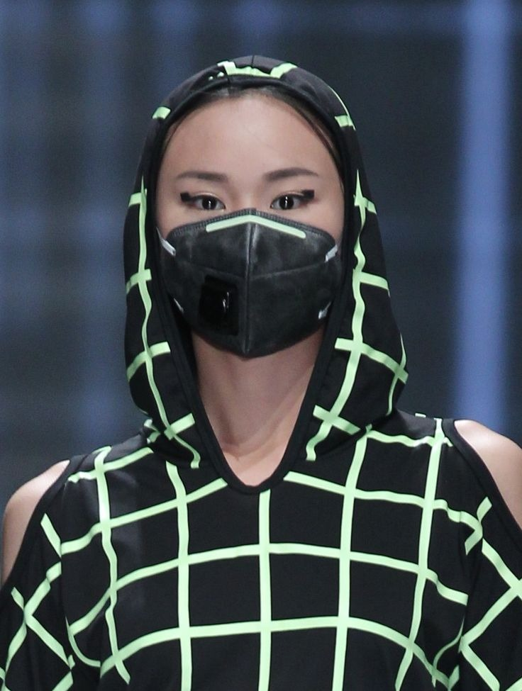
PANDEMIC-INFLUENCED STYLES
The rise of athleisure and loungewear, which are comfortable and versatile clothing styles that can be worn both at home and outside.
Masks and protective accessories have become more fashionable and personalized, as people express their style and identity through them.

Slide 8
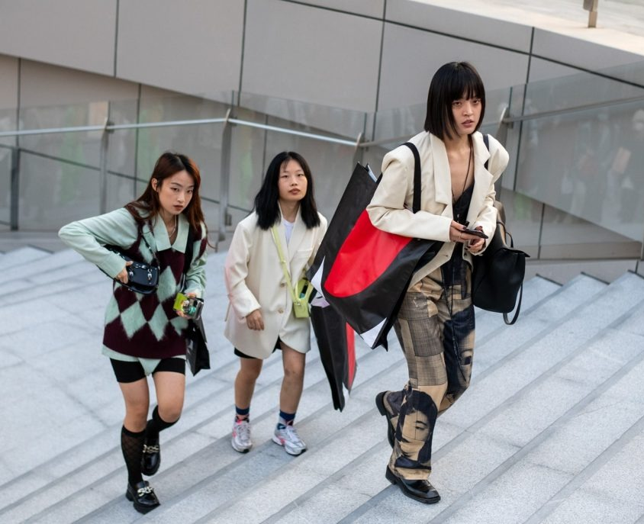
Streetwear Dominance
Streetwear Dominance in Chinese fashion is a topic that explores how streetwear, a style of casual clothing inspired by urban subcultures such as hip-hop, skateboarding, and graffiti, has become a major trend and influence in the Chinese fashion industry and culture

Slide 9
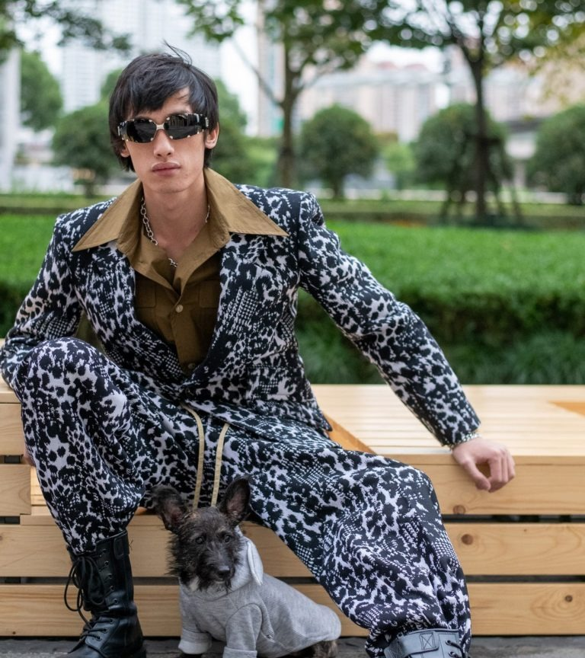
Gender fluidity
In China, men are increasingly moving towards more delicate items while females are enticed more by masculine styles, notably oversized sweatshirts and tshirts. This crossover is embraced domestically as both genders experiment with each other’s wardrobes. It reflects the influence of cultural, social, and personal factors on contemporary fashion in China and beyond.

Slide 10
SUMMARY
In conclusion, Chinese fashion trends for 2023 represent a vibrant fusion of tradition and innovation, offering a glimpse into the evolving tastes and preferences of consumers in one of the world's largest fashion markets. From the revival of traditional elements to the dominance of streetwear, sustainability consciousness, and tech-infused designs, the Chinese fashion landscape is marked by diversity and dynamism. Gender fluidity and the global recognition of local designers are indicative of a growing cultural openness. Social media influencers and digital shopping platforms continue to exert significant influence, while the enduring impact of the COVID-19 pandemic is seen in the embrace of comfortable styles. As we move forward, keeping a close watch on China's fashion evolution will be essential, as it continues to shape and influence the global fashion industry.

